Slide 1

“The absence of stress is death” - Hans Selye
Stress: pattern of physiological, behavioural, emotional and cognitive responses to real or imagined stimuli (stress as response approach)
This response ‘disturbs’ the organism
What is a “Stressor”?
The stimulus that triggers the above response
(stressors as stimuli approach)

Slide 2
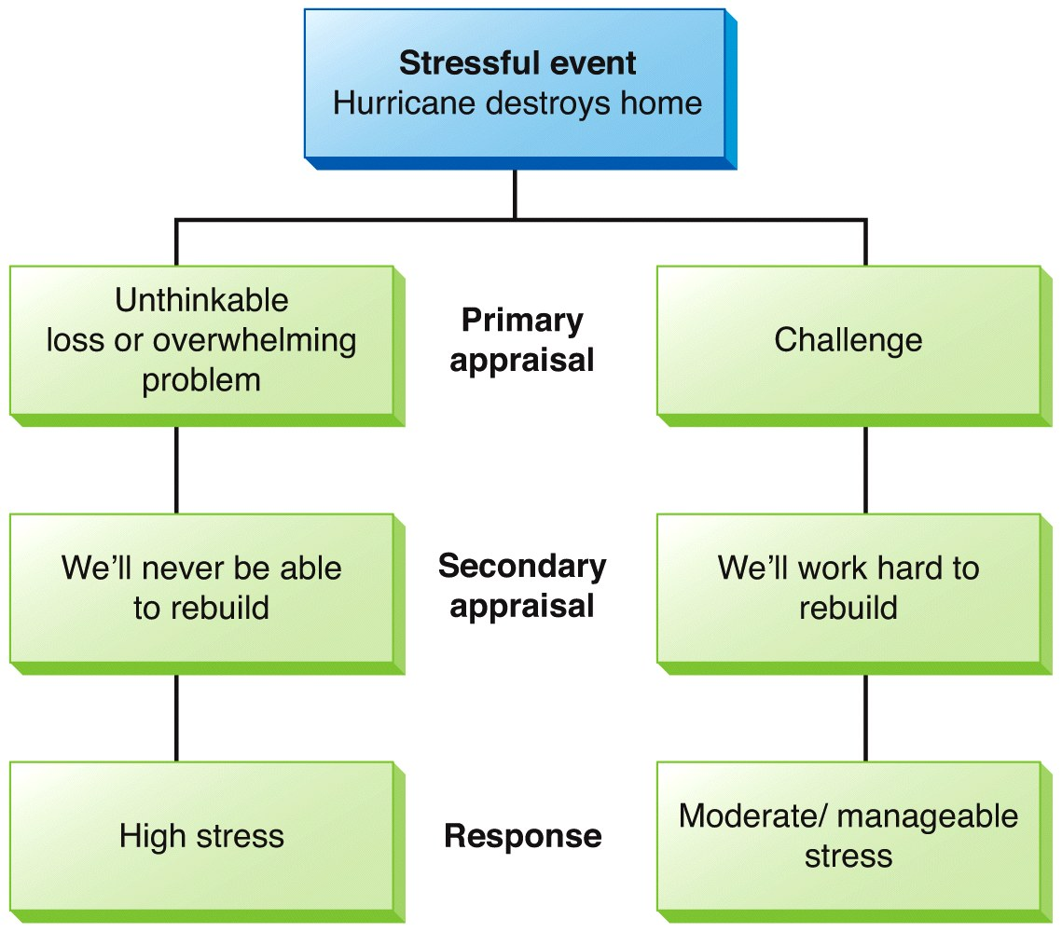
Stress as a transaction
Our appraisal of whether an event is a threat or not determines the stress response (Lazarus & Folkman, 1984)
Our emotional reaction to stressors largely depends on how we interpret them
Primary appraisal: is it a threat? How severe?
Secondary appraisal: do I have the resources to cope with this threat?

Slide 3
Kinds of Stressors
Acute vs. Chronic stressors
Acute: short-term, has defined end-point; the stressor goes away after the end-point
E.g. Almost getting run over by a car while crossing street
Chronic: long-term, no defined end-point
E.g. Unemployment
Daily Hassles “Micro-stressors”: everyday events, people, things that annoy us or “strain our ability to cope” (Lilienfeld et al., 2020, p. 434)
They range in their severity: misplacing keys frequently, long lines and wait times for things, time pressures like back to back zoom calls for work, problems with friends and partner

Slide 4
Other “types” of Stressors
Catastrophic events/”trauma”
E.g. natural disasters, wars
Socio-cultural stressors
Think back to Bronfenbrenner’s ecological model
E.g. laws (bills, mandates), leadership that impinge on the rights of groups or individuals

Slide 5
What are the sources of stress?
Life change is a major stressor
Social readjustment rating scale (SRRS)
Changes that disrupt everyday life
May be extreme, such as disaster or death of a close relative or may be fairly minor, such as starting a new job
Life changes are ranked
The higher the score, the higher the readjustment in behaviour and/or lifestyle

Slide 6
Can stress be a good thing?
Eustress
Selye distinguished between distress and eustress
Distress arises from unpleasantly valenced events/stimuli
Eustress arises from pleasantly valenced events/stimuli
Modern ways of thinking of eustress has more to do with the level of stress response (not the type of stimulus)
Yerkes-Dodson law - there is an optimal level of arousal (stress) that is needed for us to do well on certain tasks

Slide 7
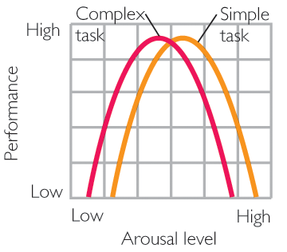
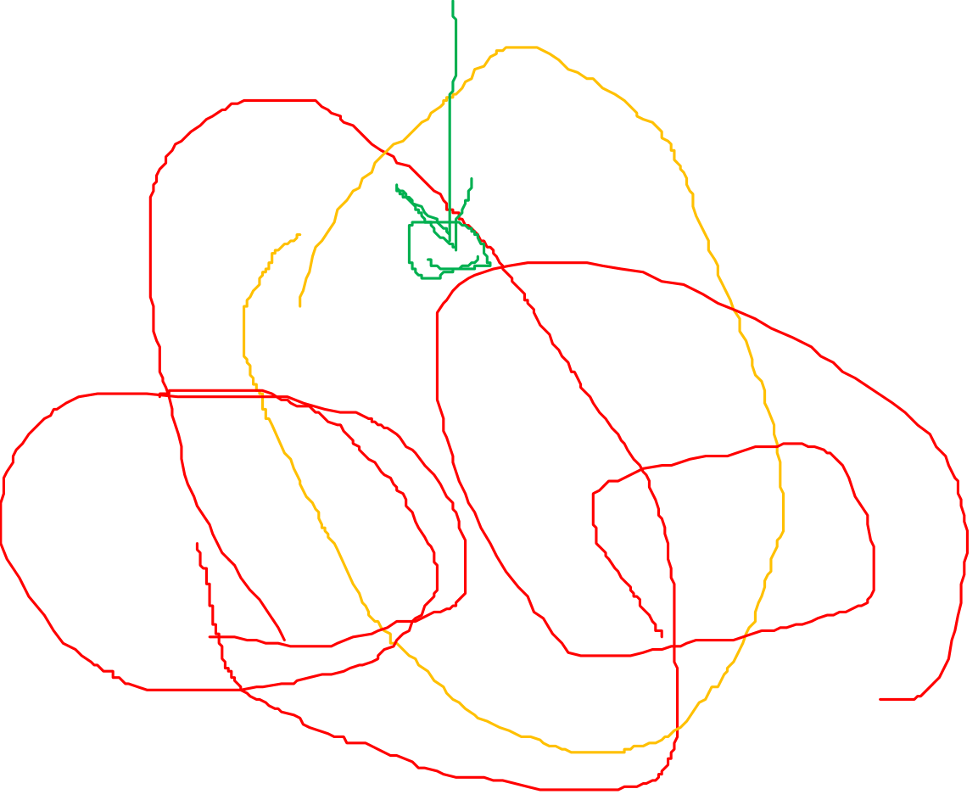
Yerkes-Dodson Law
Stress and task performance

Slide 8
Internal Sources of Stress
Perceived control: Amount of influence you feel you have over a situation and your reaction to it
Explanatory style: Attributions influence stress
Internal, stable, global attributions for negative events-> More stress
Personality characteristics: Optimistic, “Type B” personalities experience less stress, fewer stress related ailments
Type A: Hard-driving ambitious, impatient
Type B: Put selves under less pressure, more relaxed

Slide 9
Stress and the Body
Walter Cannon (re: Ch 11) described that activities of our internal organs accompany subjective emotional responses…
Characteristic physiological responses associated with stress
Increased heart rate & respiration
Increased blood pressure
Changes in digestive functioning
Sweating
Tremors

Slide 10
The Fight or Flight Response
First described by Walter Cannon (1915)
An early evolutionary adaptation that is useful in dealing with physical threats
Helps us deal with short-term problems

Slide 11
Fight or Flight Response
Increase
oxygen intake
Release stored
glucose
Divert resources
away from
digestion
Ready to expend energy,
either by fighting or by running away

Slide 12
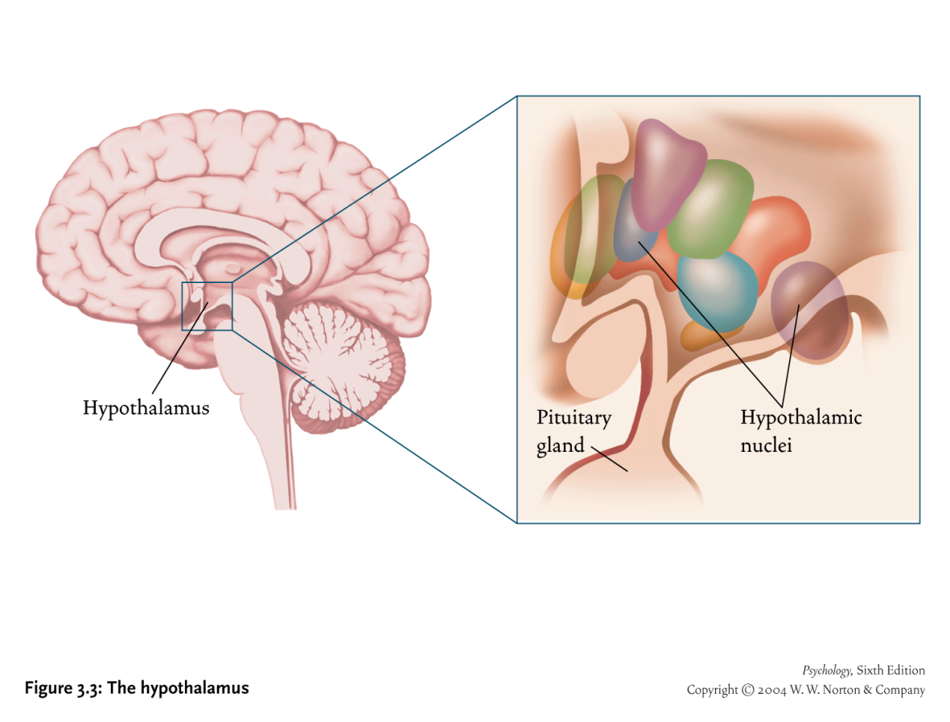
From where does this response originate?
Nervous System
Central Nervous system
Peripheral Nervous System
Somatic
Autonomic
Sympathetic
Para-sympathetic

Slide 13
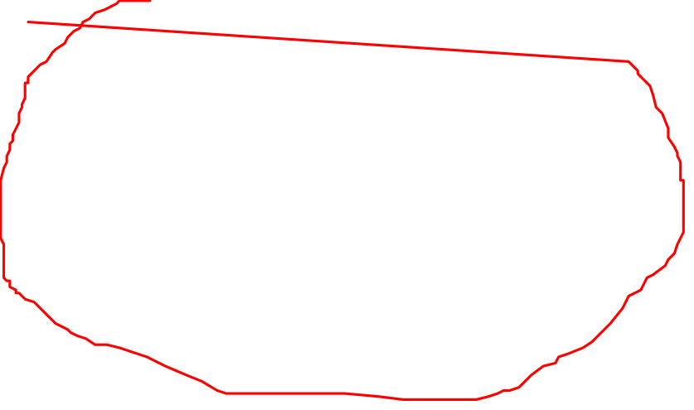
Two Stress Response Pathways
SNS (Sympathetic Nervous System)
HPA Axis
Body parts involved*: adrenal medulla, various internal organs including the heart
Substances: epinephrine, norepinephrine
* Many other parts of the brain become activated in our emotional responses!
Body parts involved*: Hypothalamus, pituitary, adrenal cortex
Substances: adrenocorticotropic hormone (ACTH), cortisol

Slide 14
Hans Selye (1907-1982)
https://www.youtube.com/watch?v=wAnWJ9ZmbJA
Please watch this short footage of a classic and interview with Selye.
(Some good life advice in there ☺ )

Slide 15
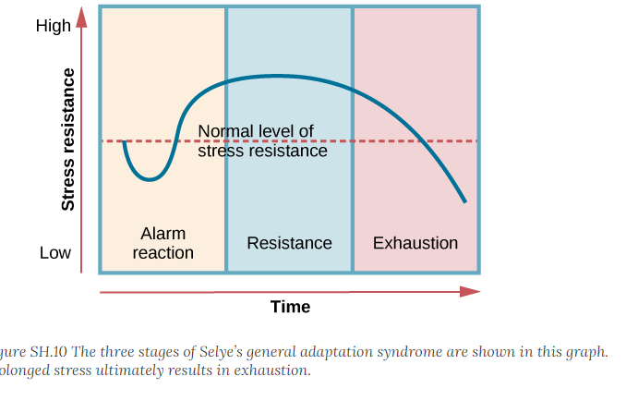
Physical Consequences of Prolonged Stress: General Adaptation Syndrome (Hans Selye)
Figure SH.10 (from your text)

Slide 16
General Adaptation Syndrome
Although Selye proposed that GAS is the same regardless of the type of stressor...
He actually only studied physical stressors on his animals
He did acknowledge individual factors
One person might experience high stress, but the same event might be a mild stressor for another

Slide 17
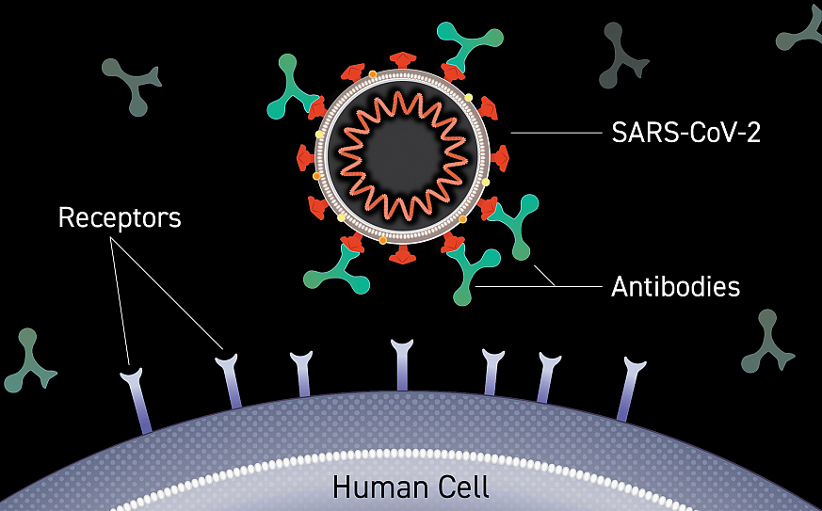
The Immune System
Helps defend against pathogens
Consists of the skin, phagocytes, lymphocytes (T and B cells), and macrophages
Phagocytes and lymphocytes
‘Killer T’ cells and ‘B’ cells are types of lymphocytes
T cells attach to viral proteins and kill off the viral cell
B cells make antibodies, which are proteins that stick to the surface of the virus, and send messages to attract more of the body’s defenses to destroy the virus
Image link: https://www.cancer.gov/news-events/cancer-currents-blog/2021/covid-19-antibodies-nci-seronet

Slide 18
Stress hormones and immune functioning
Cortisol helps us during acute stress
However, ongoing cortisol release creates inflammation (i.e., swelling, heat) in the body
Inflammation (e.g., at the site of an injury, for example) is part of our immune response… BUT…chronic inflammation itself is damaging to our bodies.
Ongoing cortisol release eventually SLOWS down our immune systems…
Physical activity/exercise is an important part of reducing of chronic inflammation in our bodies!

Slide 19
Lymphocyte functioning drops/is slower under conditions of stress
Caregiver stress has been studied in a number of studies
It is a highly relevant chronic stressor given longer life spans and accompanying declines in various aspects of health
Caring for someone with Alzheimer’s is associated with lower ability to heal from injury and decrease blood clotting (Kiecolt-Glaser’s line of research)
Strong social support around the family buffers the above effect!

Slide 20
Stress-Related Illnesses
Biopsychosocial perspective
Most conditions (physical and mental) are created/precipitated by a multitude of factors
Both physiological and psychological
… In addition to social factors
E.g. Coronary Heart disease

Slide 21
Coronary Heart Disease/Cardiovascular Disease
Blockages of arteries (therefore less oxygen to the heart)
Involves atherosclerosis, a narrowing of arteries and inflammation in artery walls
One of the top causes of death in Canada (and other countries)
Many Factors
Family history of CHD/CVD
Smoking, not enough physical activity,
Autonomic reactivity to stressors
Type A personality & trait hostility
Low SES (socioeconomic status)

Slide 22
Autonomic Reactivity
Exaggerated stressor-related autonomic responses are a well-studied factor in CHD/CVD
Autonomic responses (such as increased heart rate, blood pressure and oxygen consumption) are “beyond the metabolic and behavioural demands of a given stressor” (Ginty et al. 2017, p. 3)
Predictor of various conditions involved with CHD/CVD (Ginty et al., 2017)
Ventricular mass (i.e., hypertrophy/enlargement), which in and of itself is a strong predictor of CVD related death
Fast-progressing atherosclerosis
Hypertension (i.e., high blood pressure)
Heart attack
Death

Slide 23
COPING
Selye viewed stress as an inevitable part of life. He once said in an interview that “only the dead have no stress”.
So… we need to learn how to temper our appraisals to our benefit
And … heighten our awareness of different kinds of coping that most of us already use

Slide 24
Why is control important to stress?

Slide 25
Decisional control: can we choose among different courses of action in life situations?
Informational control: can we get information about a stressful event?
Both can increase our sense of perceived control: Amount of influence you feel you have over a situation
If we believe we can control an outcome, we feel less stressed

Slide 26
Behavioural Control/“Problem Focused Coping”
Also called “problem focused coping”
Figuring out ways to decrease or get rid of source of stress
Generating possible solutions and acting on the best one
As opposed to avoidance, which is another strategy we might use

Slide 27
Cognitive Control
Includes Emotion-focused coping
Recall that it’s our interpretation of events, not events themselves, that produce stress
Example: You may interpret a small change of plans as a welcome break, or as a terrible catastrophe!
Ways to reduce stress through reappraisal:
changing your perception of the stressful situation
Try to shift how you feel

